Slide 1
Predicting Drum Vibrations Using the Polar Wave Equation
Alexander Brimhall, Zane Perry, Luke Sellmayer

Slide 2
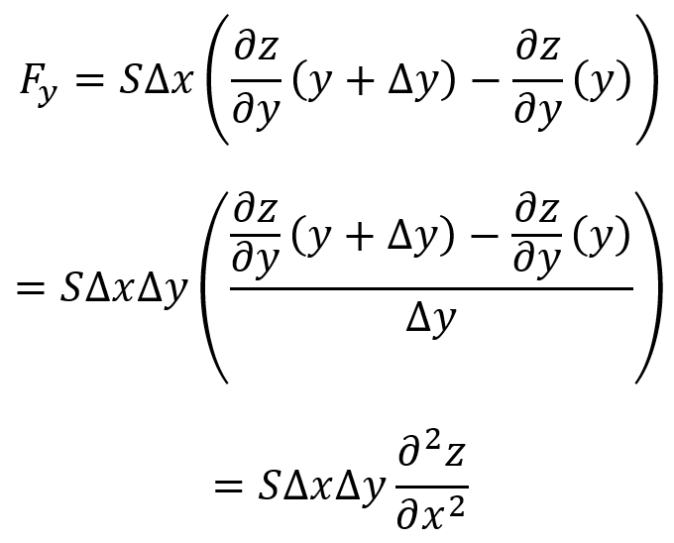
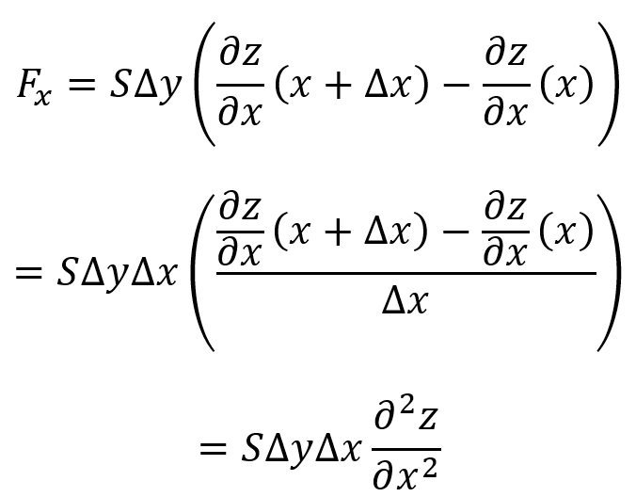
Deriving the (2 + 1)D Wave Equation
SΔx
SΔx
SΔy
A_{R} = ΔxΔy
Δy
+z
SΔy
Δx
-x
SΔx
SΔx
+y
+z
m_{R} = σΔxΔy
R
+y
SΔy
-x
r = R
+x
+z
SΔy
-y
+y
-z
+x

Slide 3
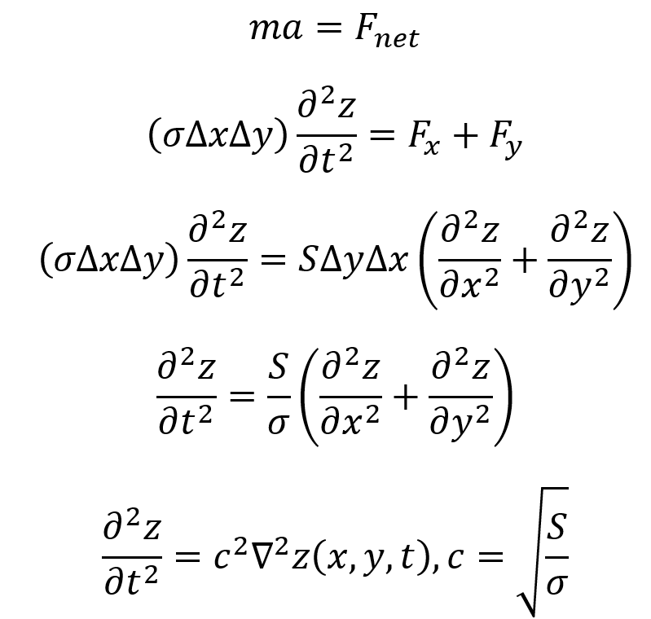
Deriving the (2 + 1)D Wave Equation
Assumptions:
Density is constant across the drum head
Only forces acting on rectangular patches are tension forces, and tension is constant
Points in membrane only move in transverse direction up and down, and not parallel to the xy-plane

Slide 4
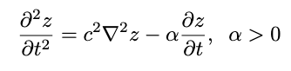
Physical Representation
Telegraph Equation
Can be used to account for friction and other damping forces on the drum
Does not change spatial solution, only time

Slide 5
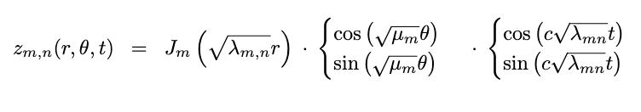
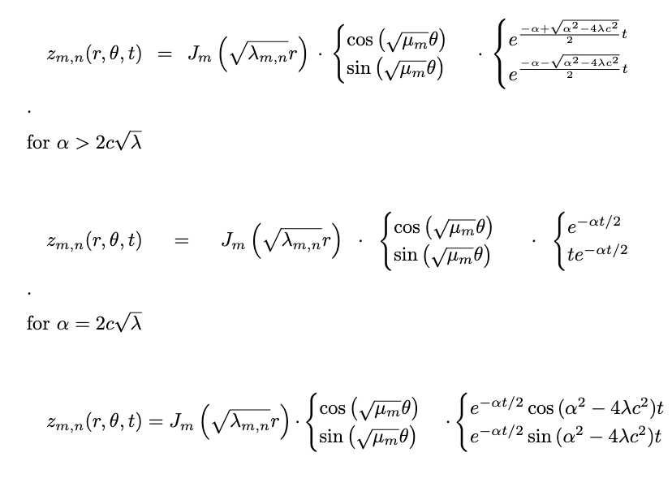
Solutions
Undamped
Damped

Slide 6
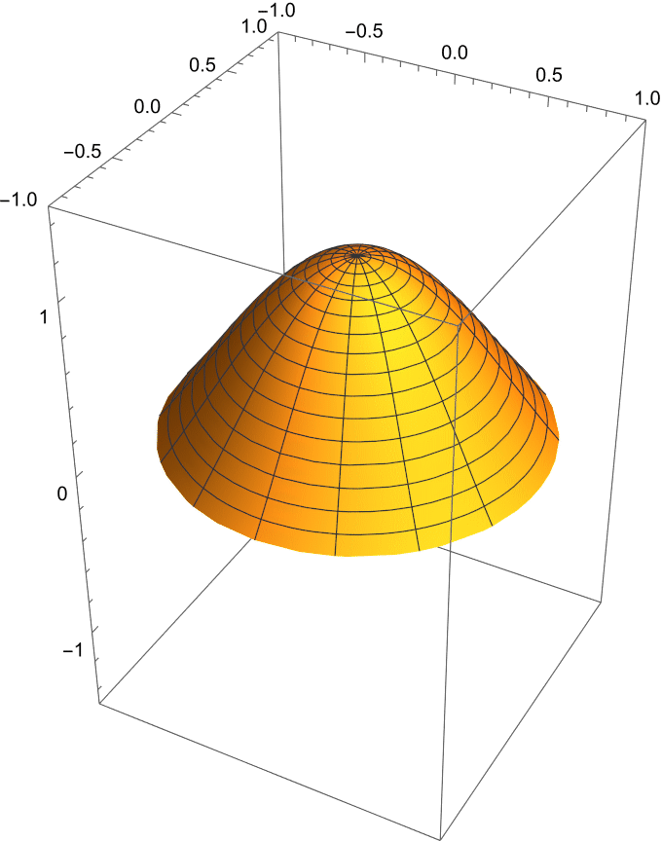
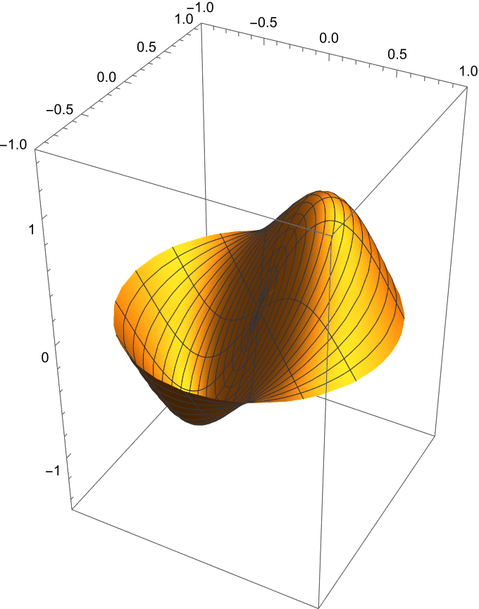
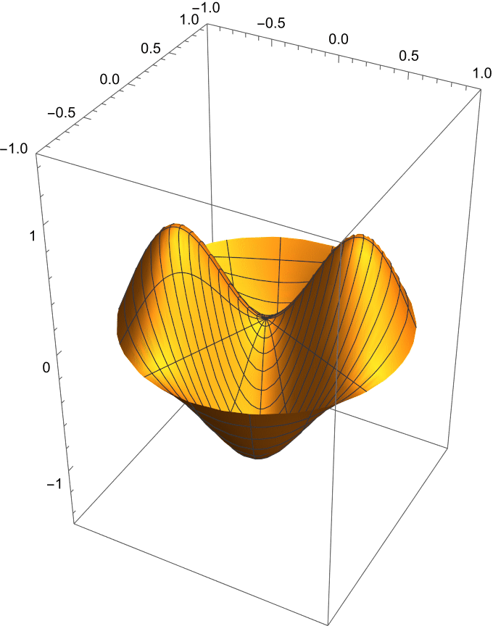
Undamped Modes
Mode (0, 1)
Mode (1, 1)
Mode (2, 1)

Slide 7
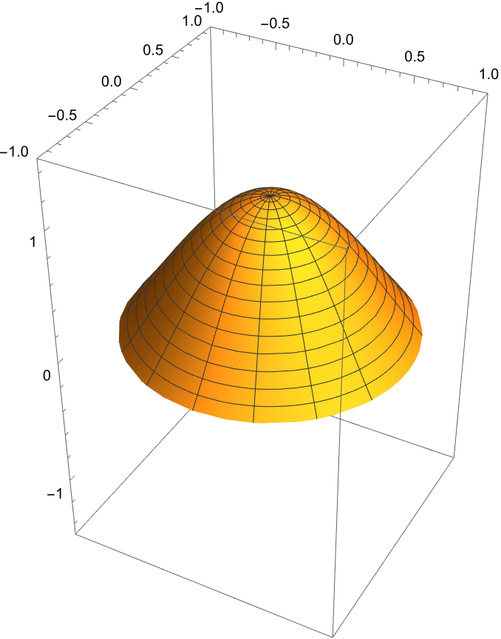

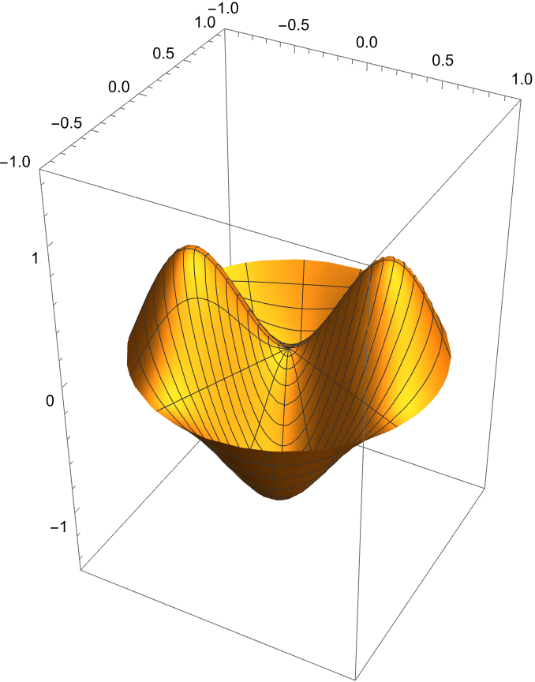
Damped Modes
Mode (0, 1)
Mode (1, 1)
Mode (2, 1)

Slide 8

Comparison to Real World

Slide 9
Experimental results
Used 6 inch radius floor tom
Polyethylene Terephthalate drum head with density around 1.38 g/cm³
Tensioned with roughly 16 N/cm of force

Slide 10
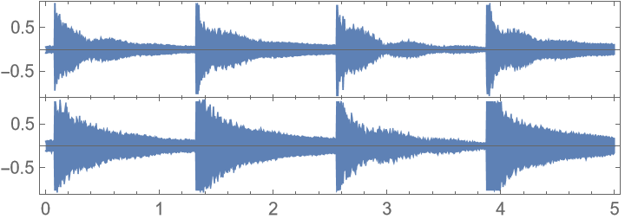
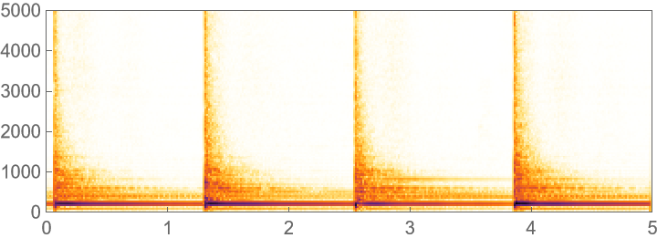
Spectrogram and Waveform - Center hit

Slide 11
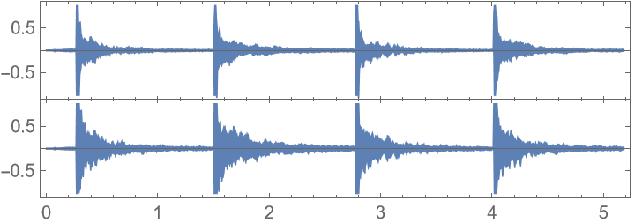
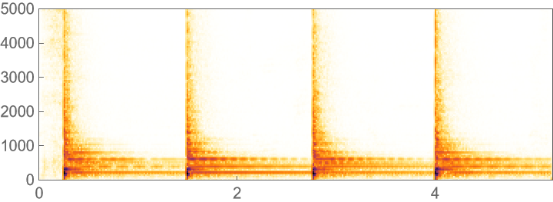
Spectrogram and Waveform - Off-center hit

Slide 12
Conclusion
Striking the drum in the center results in lower frequencies being more pronounced
When struck off center, frequencies are more varied, resulting in a fuller sound
The frequency of individual drum modes is not dependent on where or how hard the drum is struck
Location and velocity of the drum strike still result in a different sound
This is due to changes in amplitude and a difference of overlapping frequencies
The tension and material of the drum head determine the resulting frequency

Slide 13
Further goals
Construct a more accurate model for initial conditions, primarily for strikes that are off center on the drum head
Take measurements for assumed constants in experimental tests
Measure drum tension rather than just use an assumed average

